Slide 1
Android Application Development (I)
Practice - Requirement

Slide 2
Agenda
Self Introduction
Intellectual Property Rights
Project Introduction
Android Introduction
Get Started with Android
Requirement
Object-Oriented Analysis and Design
Scrum
Coding
Acceptance Test Criteria
Publish Application
Notes:
Object-oriented analysis and design (OOAD) is a software engineering approach that models a system as a group of interacting objects. Each object represents some entity of interest in the system being modeled, and is characterised by its class, its state (data elements), and its behavior. Various models can be created to show the static structure, dynamic behavior, and run-time deployment of these collaborating objects. There are a number of different notations for representing these models, such as the Unified Modeling Language (UML).
Object-oriented analysis (OOA) applies object-modeling techniques to analyze the functional requirements for a system. Object-oriented design (OOD) elaborates the analysis models to produce implementation specifications. OOA focuses on what the system does, OOD on how the system does it.
Ref: http://en.wikipedia.org/wiki/Object-oriented_analysis_and_design
IFRS - International Financial Reporting Standards
GAAP - Generally Accepted Accounting Principles

Slide 3
Outline:
Why Requirements?
What’s User Stories?
Summary
Notes:
Why do we have requirements?
-To be sure that we meet the expectations of the customers regarding scope.
The customer must be able to validate the product to see it correctly reflects his needs and expectations.
--------------------------
-By having this documented at the user story level greatly increases the availability of the info (both physically and understandability wise), which in turn reduces the overhead of chasing down and asking an actual SW person.
-It also, reduces the risk of ’loosing’ knowledge, e.g. when the people involved in the development of a particular functionality change jobs, when the actual behaviour is modified by others later on etc.
- To describe & document the supported functionality in a way that can be read & understood by a wide SEMC-internal audience.
- A lot more compacted format than e.g. reading the source code &/ test cases.
--------------------------
Receivers/Users:
Internal stakeholders who need to know what functionality is supported in the finished version, e.g. to propose new propositions that are currently not supported.
SEMC people interacting with customers (operators) who want to know what is supported, primarily CPM (Customer Portfolio Mgmt.) E.g. for SoC (Statement of Compliance) work, in discussions that lead to ranging decisions.
SEMC Internal customers like Engineering, Product projects, who need to know what behaviour to expect in a SW release and what is not (in order to know if things are bugs or new reqs.) Over time, products will test legacy functionality.
SW Internal: documentation on what behaviour the product is supposed to meet. Needed to assess reported issues, and for SW people to be able to find out behaviour without reading code/test cases (e.g. new people, non-developers/testers.) Used, e.g.
when FAT assess an defect report on functionality impl by (disolved) feature team,
When new feature modifies/conflicts existing behaviour, the feature team can by reading the reqs (for main) identify affected old reqs and their source/stakeholder, and based on this information discuss (lead by Feature Scope Owner) how to integrate/replace with new requirements.
When identifying critial user stories that should be part of the main branch quality monitoring
For identifying user stories touching on new features, in order, to identify test cases to use for regression for a feature.

Slide 4
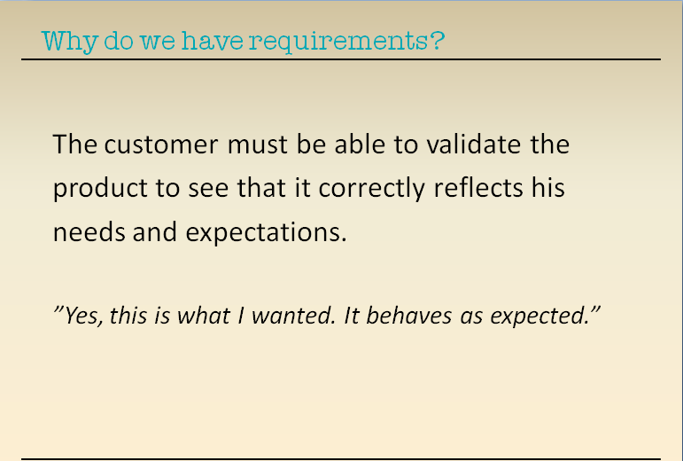
Requirement
[Go to Online Training Course]
Notes:
Why do we have requirements?
-To be sure that we meet the expectations of the customers regarding scope.
The customer must be able to validate the product to see it correctly reflects his needs and expectations.
--------------------------
-By having this documented at the user story level greatly increases the availability of the info (both physically and understandability wise), which in turn reduces the overhead of chasing down and asking an actual SW person.
-It also, reduces the risk of ’loosing’ knowledge, e.g. when the people involved in the development of a particular functionality change jobs, when the actual behaviour is modified by others later on etc.
- To describe & document the supported functionality in a way that can be read & understood by a wide SEMC-internal audience.
- A lot more compacted format than e.g. reading the source code &/ test cases.
--------------------------
Receivers/Users:
Internal stakeholders who need to know what functionality is supported in the finished version, e.g. to propose new propositions that are currently not supported.
SEMC people interacting with customers (operators) who want to know what is supported, primarily CPM (Customer Portfolio Mgmt.) E.g. for SoC (Statement of Compliance) work, in discussions that lead to ranging decisions.
SEMC Internal customers like Engineering, Product projects, who need to know what behaviour to expect in a SW release and what is not (in order to know if things are bugs or new reqs.) Over time, products will test legacy functionality.
SW Internal: documentation on what behaviour the product is supposed to meet. Needed to assess reported issues, and for SW people to be able to find out behaviour without reading code/test cases (e.g. new people, non-developers/testers.) Used, e.g.
when FAT assess an defect report on functionality impl by (disolved) feature team,
When new feature modifies/conflicts existing behaviour, the feature team can by reading the reqs (for main) identify affected old reqs and their source/stakeholder, and based on this information discuss (lead by Feature Scope Owner) how to integrate/replace with new requirements.
When identifying critial user stories that should be part of the main branch quality monitoring
For identifying user stories touching on new features, in order, to identify test cases to use for regression for a feature.

Slide 5
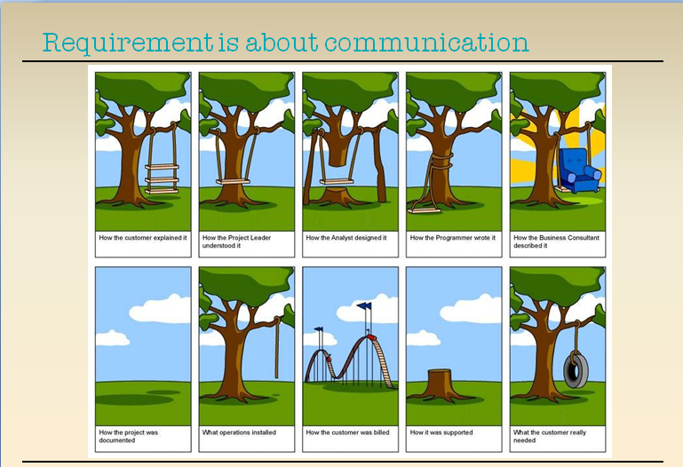
Requirement Cont.
Customer Explain
Project Leader
Analyst
Programmer
Business Consultant
How the project is documented
What operation installed
How customer is billed
How it is supported
What customer really need
Notes:
Those who want the Software must communicate with those who build it
Ask the audience:
Have you worked in a project without requirements?
What happens if the requirements are not communicated?
Communication problem
This picture illustrates the difficulties involved when communicating requirements.
Had the communication worked, the picture would be the same for all the parties.
All the different parties involved interpreted the customer’s need in different ways
Not even the customer knew what he/she actually needed. The elicitation failed, nobody questioned the customers explanation. (thrawling)
The customer had expectations that were not fulfilled, e.g. in regards to support and documentation
COMMUNICATION BETWEEN BUSINESS VS DEVELOPMENT!

Slide 6
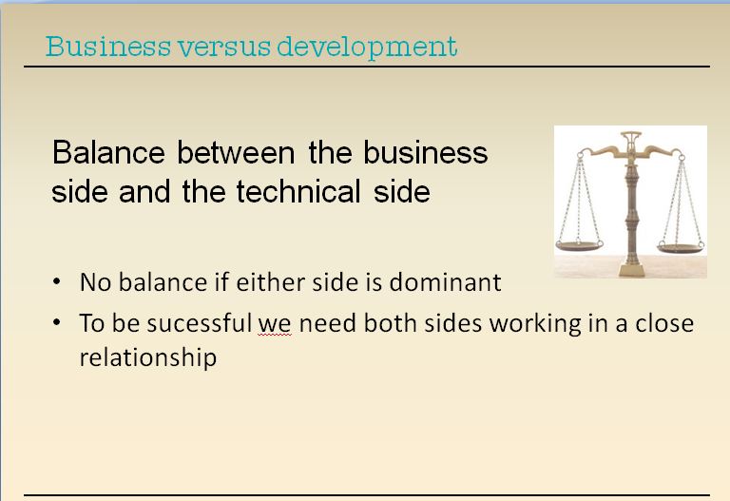

Requirement Cont.
Business Dominant
Technical Dominant
Notes:
SW development needs to be a joint effort to be sucessful
In order to achieve a good balance we need to communicate. The User stories help us to talk requirements.
It is important that the scopeowner is present and explain the purpose of the feature and its business case.
Reqs/Scoping process aims at balancing business aspects (market needs, business value/prios) against engineering aspects (technical possibilities & costs).
The business side can not dictate the deadline
And the tech side has to prioritize according to the business need.
To be sucessful we need both sides working in close relation.
Business domination -> scope & timelines set with little regard for reality and developer understanding of reqs, i.e. OVERSCOPING
Developer domination ->technology focus, missing user/market view and drive
imgurl=http://www.raddningkarlstad.se/web/krt/raddningstjansten_mm.nsf/lupGraphics/vag.jpg/%24file/vag.jpg&imgrefurl=http://www.raddningkarlstad.se/web/krt/raddningstjansten.nsf/%24all/E6F31948FFDE711BC125760E0030FF25&usg=__36X9n0D2ifmNRxdjo3N0VbF6-ak=&h=200&w=200&sz=10&hl=sv&start=12&itbs=1&tbnid=v3b2RLndcweC6M:&tbnh=104&tbnw=104&prev=/images%3Fq%3Dbalansv%25C3%25A5g%26hl%3Dsv%26client%3Dfirefox-a%26hs%3DXhh%26rls%3Dcom.ubuntu:en-US:unofficial%26tbs%3Disch:1

Slide 7
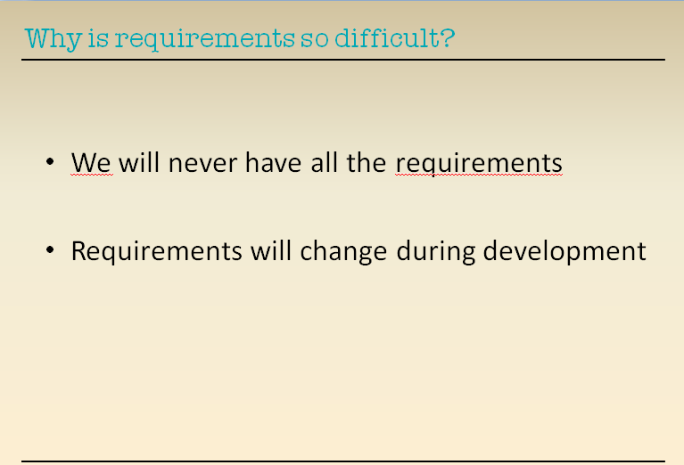
Requirement Cont.
Notes:
Why is requirements so difficult
We have tryed before to work with the waterfall model and create all the requirements first, followed by writing the specifications and after that start implementation and then test.
It failed and we had a lot of de-scoping.
We will never have all the requirements
Requirements will change during development
Predicting software requirements is difficult.
It is difficult from the start to know all the details to make the right decions.
It is also hard to make estimations on how long it will take to develop the requirements.
It is almost impossible to say what exactly will be delivered in a feature and at what date.
How can we overcome the difficulties?

Slide 8
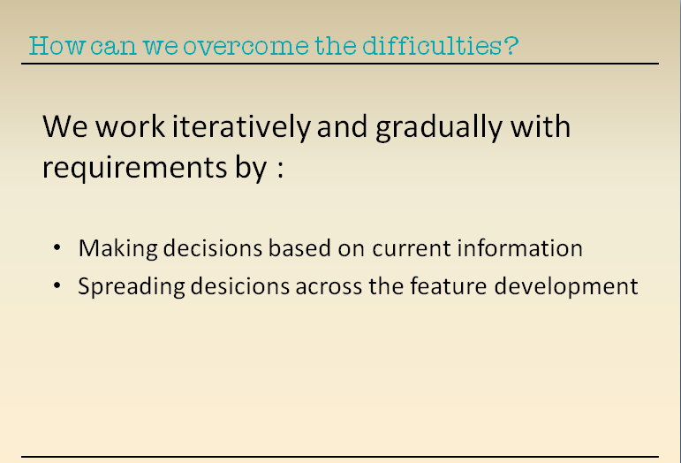
Requirement Cont.
Notes:
A way forward is to try and make desicions based on current info.
-We work iteratively and gradually with requirements by:
- Make decisions based on current information. Then you do not need to take all decisions before starting up a feature
-Spread desicions across the feature development
We take a decision when it is most appriopriate to take it.
Important principle: Requirements are identified Just-In-Time, not in a big upfront batch task. This means that the requirements, or needs / supported functionality, are identified and captured & documented iteratively throughout the Scoping and Development (DEF + DEV) parts of the process and maintained in the maintenance process.
It is important that the scopeowner is present when discussing the the requierments and what the purpose of the feature is and what the expectations are.
(Using User stories is a technique for describing reqs at a high level in a way that business people can understand and discuss the requirements. A user story (in our process) is to describe a full scenario of something a user (human or otherwise) can do with the system.)

Slide 9
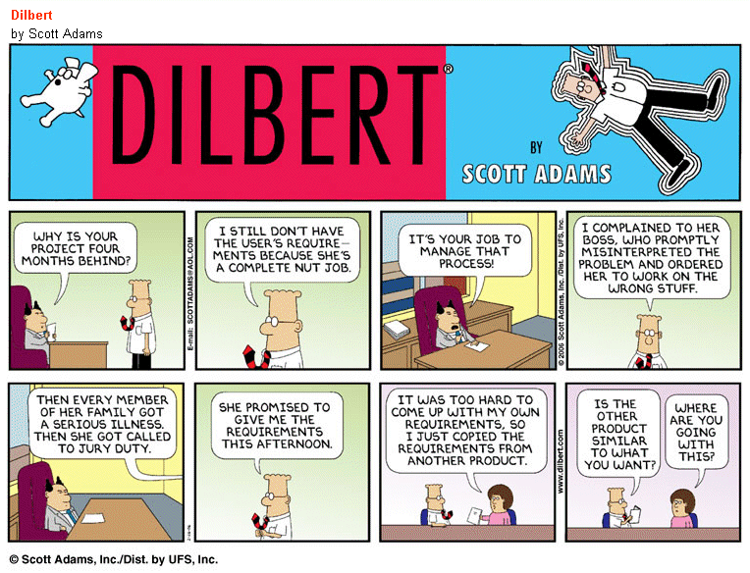
Requirement Cont.
Notes:
Pause

Slide 10
Agenda
Why Requirements?
What’s User Stories?
Summary
Notes:
Why do we have requirements?
-To be sure that we meet the expectations of the customers regarding scope.
The customer must be able to validate the product to see it correctly reflects his needs and expectations.
--------------------------
-By having this documented at the user story level greatly increases the availability of the info (both physically and understandability wise), which in turn reduces the overhead of chasing down and asking an actual SW person.
-It also, reduces the risk of ’loosing’ knowledge, e.g. when the people involved in the development of a particular functionality change jobs, when the actual behaviour is modified by others later on etc.
- To describe & document the supported functionality in a way that can be read & understood by a wide SEMC-internal audience.
- A lot more compacted format than e.g. reading the source code &/ test cases.
--------------------------
Receivers/Users:
Internal stakeholders who need to know what functionality is supported in the finished version, e.g. to propose new propositions that are currently not supported.
SEMC people interacting with customers (operators) who want to know what is supported, primarily CPM (Customer Portfolio Mgmt.) E.g. for SoC (Statement of Compliance) work, in discussions that lead to ranging decisions.
SEMC Internal customers like Engineering, Product projects, who need to know what behaviour to expect in a SW release and what is not (in order to know if things are bugs or new reqs.) Over time, products will test legacy functionality.
SW Internal: documentation on what behaviour the product is supposed to meet. Needed to assess reported issues, and for SW people to be able to find out behaviour without reading code/test cases (e.g. new people, non-developers/testers.) Used, e.g.
when FAT assess an defect report on functionality impl by (disolved) feature team,
When new feature modifies/conflicts existing behaviour, the feature team can by reading the reqs (for main) identify affected old reqs and their source/stakeholder, and based on this information discuss (lead by Feature Scope Owner) how to integrate/replace with new requirements.
When identifying critial user stories that should be part of the main branch quality monitoring
For identifying user stories touching on new features, in order, to identify test cases to use for regression for a feature.

Slide 11
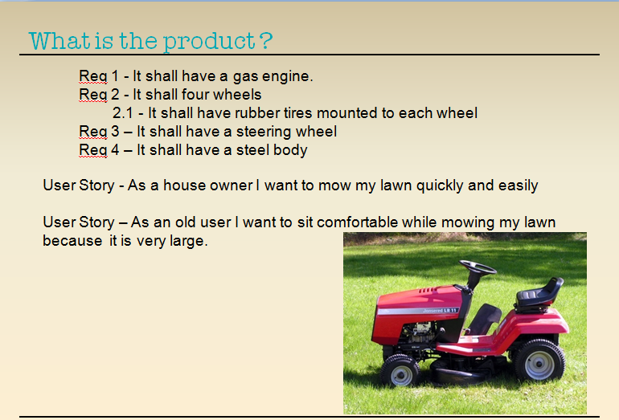
Requirement Cont.
What is user story
Notes:
Show how powerful User stories are compared to a detail spec when it comes to providing an understanding of what the desired product is.
User stories support flexibility, no details in the begining
Right size for planning
Support for iteration

Slide 12
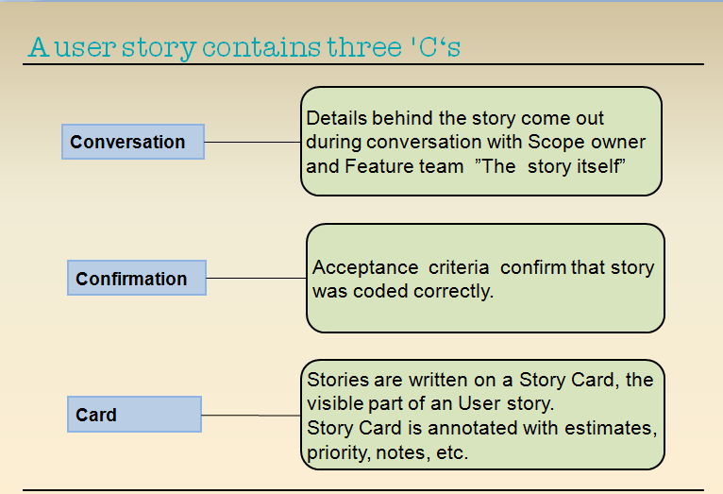
Requirement Cont.
Notes:
The three parts of a User story
Why conversation ? :
- User stories shifts focus from WRITING to TALKING
It is a promise to Scope owner from Feature Team that we will
come and talk to you before we start this user story
(- Easier to associate to stories than detail requirement.)
Why confirmation ? :
We need to know when we are done without stating every possible test. We use criteria.
Why a card ? :

Slide 13
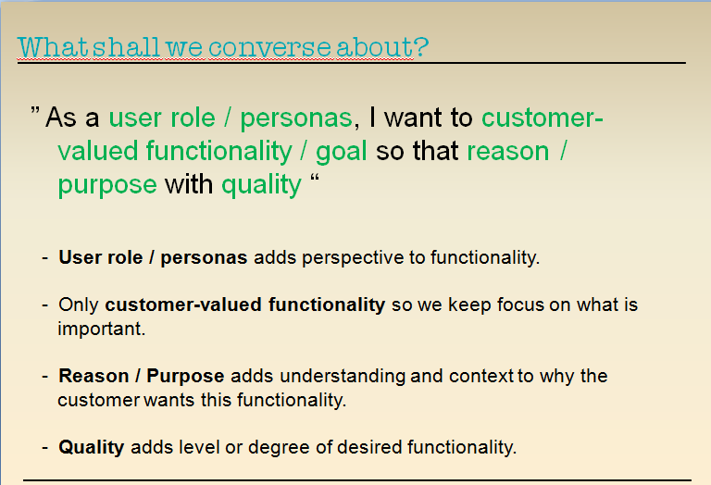
Requirement Cont.
Notes:
Done in definition
User role or Personas – Who is “the user” ?
- Many projects mistakenly assume there’s only one user : “The user”
- Write all stories from one user’s perspective
- Assume all users have the same goals
- Leads to missing stories
customer-valued functionality -
- What is value to the user?
Reason or Purpose – Why do “the user” want this functionality ?
- We want things for different reason. Help understand why the user want it
- Can be more than one reason why a user wants this functionality. If it adds clarification or context – add it!
- Adds context on how the user will use the functionality and why.
Quality – Does the functionality come in different flavors ?
- We have different expectations on functionality. Is it good enough ?
- Is performance important ? Speed!
- Is usability important ? Ease of use!
- Is understandability important ? Ease of learning! What went wrong when I did this?

Slide 14
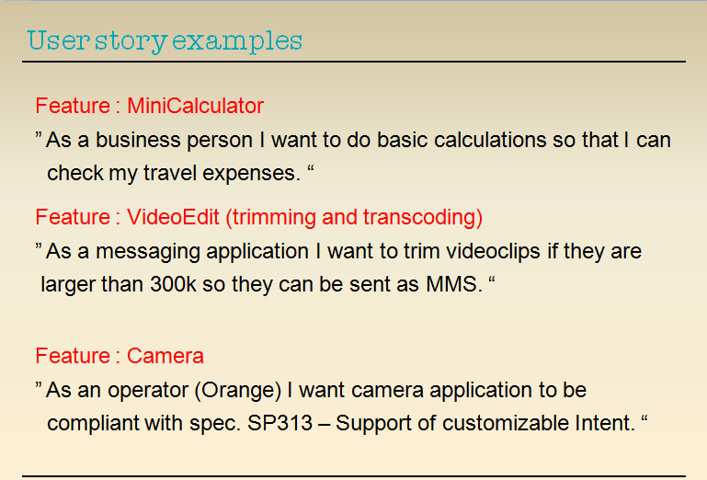
Requirement Cont.
Notes:
Compare to template and discuss.

Slide 15
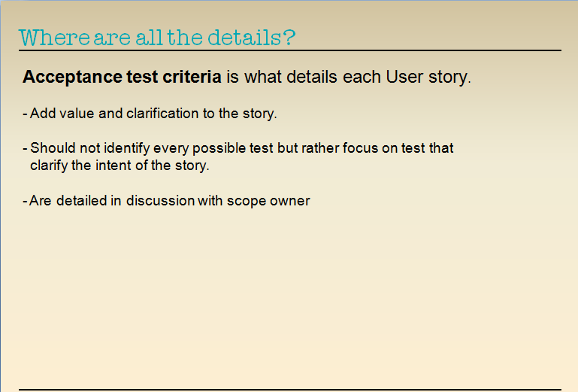
Requirement Cont.
Notes:
Condition of Satisfaction , Criteria?
(not use word test for negativity and detail level)‏
Done in execution

Slide 16
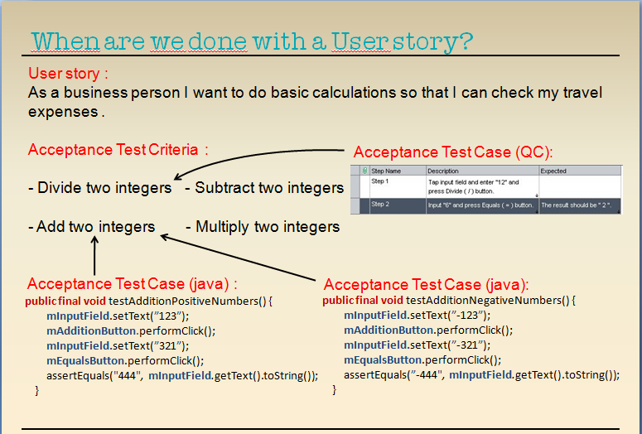
Requirement Cont.
Notes:
Concept NOT a tool, (Acceptance Test Framework)‏
At minimum rerun ALL after each story is completed.
Focus on automated!!
Still write unit / function test to verify internal functionality, not all tests must be connected to a AT.
Connecting a Test cases (by annotation) to a Acceptance test is what turns the Test Case into an Acceptance Test Case
Variation of input and all special cases are handled in “Unit” testcases. Should not be ATC.
When all the Acceptance Test Criteria is verified or confirmed by our Acceptance
Test Cases.
- These test cases can be manual or automatic.
- Any test case directly connected to a criteria is an Acceptance Test Case.

Slide 17
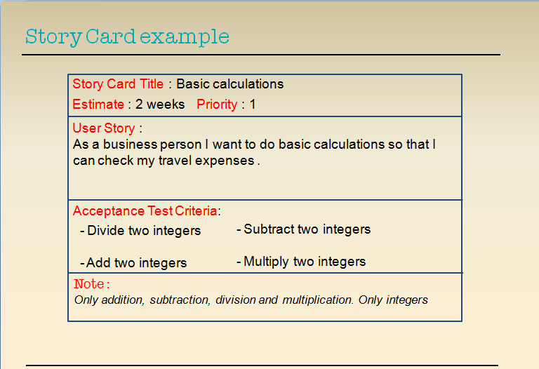
Requirement Cont.
Notes:
//Where do write them down? Change titile to ”What about the Story Card?”. Remove info so it is empty and add it from animation.
Do not use numbers, use Title. Easier when discussing them. Story Card is excellent when doing logic network. Never store them in two places. Either tool (QC) or Story Card.
Story Card template
We use a title for each card to refer to them :
Because user stories can be long and title is short
We do not want numbers because they tend to change and does not say anything about the user story
We need a title for the tool (QC)

Slide 18
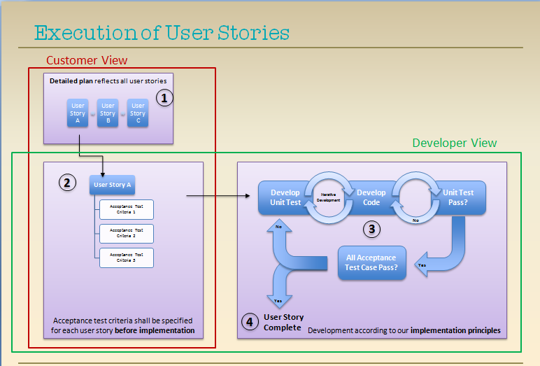
Requirement Cont.
Notes:
We need a slide with examples! Connect to Story Card again? Redo in Visio for same ”feel” of layout.
The detailed plan shows the next user story to be developed.
Before implementing the user story, acceptance test criteria must be specified. This is
Development is done according to our implementation principles.
A user story is complete when all test cases pass (all acceptance and all unit test case)
Additional info:
The implementation principles
All code development in feature teams shall have accompanying, if possible automated test cases passing the following criteria:
All test cases shall be driven by a user story.
All test cases shall be specified before implementing the corresponding code (iteratively)
Acceptance test cases shall be specified for each user story. All user stories shall be covered by acceptance test cases.
Unit test cases and acceptance test cases shall serve as internal acceptance test cases for the code owner.
Unit and acceptance test cases are part of code delivery, and version & configuration managed preferably in a way integrated with the code.
A demonstrated 100% pass rate before feature integration, generating code coverage as specified by the applicable effective KPI set.
Integration of developed code may not cause other test cases to fail in the existing asset. It is the responsibility of the feature team to validate and if applicable update and integrate any such test cases

Slide 19
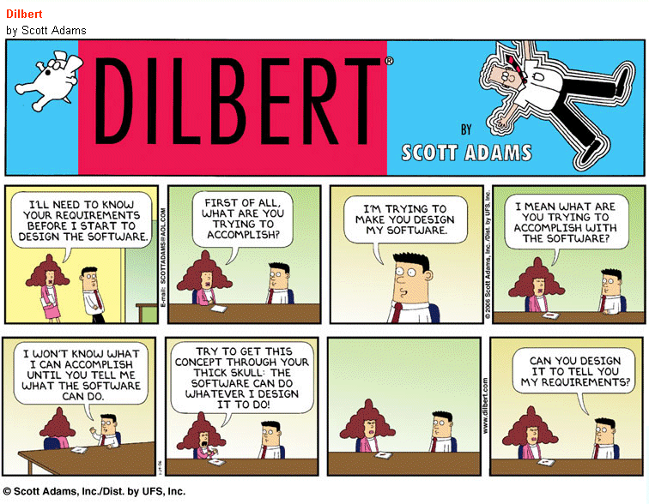
Requirement Cont.
Notes:
Pause

Slide 20
Agenda
Why Requirements?
What’s User Stories?
Summary
Notes:
Why do we have requirements?
-To be sure that we meet the expectations of the customers regarding scope.
The customer must be able to validate the product to see it correctly reflects his needs and expectations.
--------------------------
-By having this documented at the user story level greatly increases the availability of the info (both physically and understandability wise), which in turn reduces the overhead of chasing down and asking an actual SW person.
-It also, reduces the risk of ’loosing’ knowledge, e.g. when the people involved in the development of a particular functionality change jobs, when the actual behaviour is modified by others later on etc.
- To describe & document the supported functionality in a way that can be read & understood by a wide SEMC-internal audience.
- A lot more compacted format than e.g. reading the source code &/ test cases.
--------------------------
Receivers/Users:
Internal stakeholders who need to know what functionality is supported in the finished version, e.g. to propose new propositions that are currently not supported.
SEMC people interacting with customers (operators) who want to know what is supported, primarily CPM (Customer Portfolio Mgmt.) E.g. for SoC (Statement of Compliance) work, in discussions that lead to ranging decisions.
SEMC Internal customers like Engineering, Product projects, who need to know what behaviour to expect in a SW release and what is not (in order to know if things are bugs or new reqs.) Over time, products will test legacy functionality.
SW Internal: documentation on what behaviour the product is supposed to meet. Needed to assess reported issues, and for SW people to be able to find out behaviour without reading code/test cases (e.g. new people, non-developers/testers.) Used, e.g.
when FAT assess an defect report on functionality impl by (disolved) feature team,
When new feature modifies/conflicts existing behaviour, the feature team can by reading the reqs (for main) identify affected old reqs and their source/stakeholder, and based on this information discuss (lead by Feature Scope Owner) how to integrate/replace with new requirements.
When identifying critial user stories that should be part of the main branch quality monitoring
For identifying user stories touching on new features, in order, to identify test cases to use for regression for a feature.

Slide 21
Summary
Requirement
Communication from all’s perspective
Customer
Internal stakeholder
Engineering project/product team
SW development
Balance between business and engineering
Close collaboration
Market/Business value VS. technique possibility/cost
Iteratively work with requirement
Make decision based on current information
Spread decision across development team

Slide 22
Summary
User Story
What’s user story
Describe the full scenarios of something that end user can do with system
Three Cs contained in user story
Conversation, Confirmation and Card
What shall we converse about user story?
User roles/Personas, Customer-valued functionality/Goal, Reason/Purpose and Quality
User story card
Execution of user story
User story -> Acceptance Test Case (Mapped to Acceptance criteria -> Acceptance Criteria Satistified -> User story completed)

Slide 23
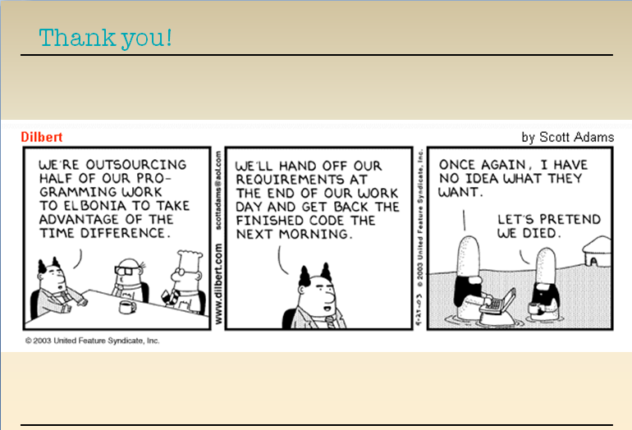
Requirement Cont.

